Slide 1
ELUCIDATING DRUG-DRUG INTERACTIONSUNDERLYING DRUG POLYPHARMACY PROFILES
Jorge Hernansanz

Slide 2
INDEX
Outline of first phase of the project
Description of the different databases used
Drugbank
KEGG
NDF-RT
TWOSIDES
DDI CORPUS 2013

Slide 3
OUTLINE
- The first phase of this project consists of recollecting DDIs information from publicly available databases.
The data will be tidy and treated so we can have a linkage network and
be able to relate every identifiers with its characteristics. A final good idea would be integrating all data into a SQL database (To discuss).
As for databases, we have chosen five of them, covering the different
fields that DDIs can be extracted from. We have extracted information from Pharmacovigilance (Drugbank, KEEG, and TWOSIDES), clinically-oriented data (NDF-RT) and NLP corpora (DDI CORPUS 2013) databases.

Slide 4
DRUGBANK
- Obtained from XML Drugbank database
- Obtained from GitHub account PDDI datasets

Slide 5
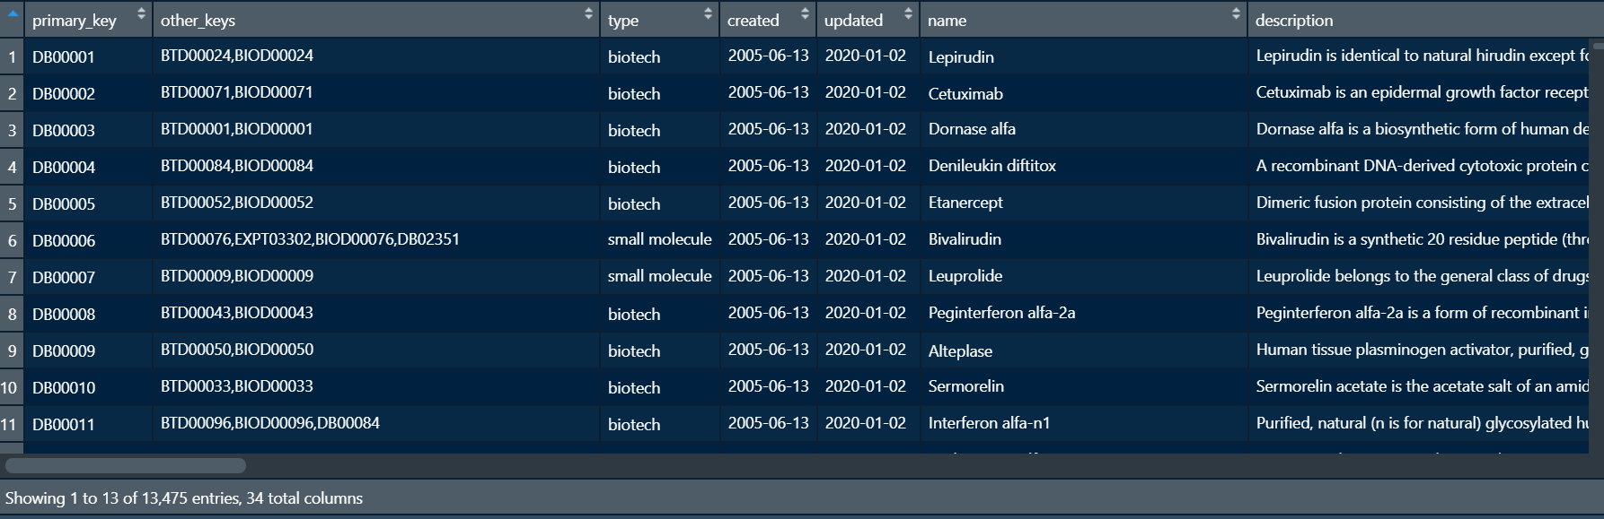
XML DATABASE; DRUGS

Slide 6
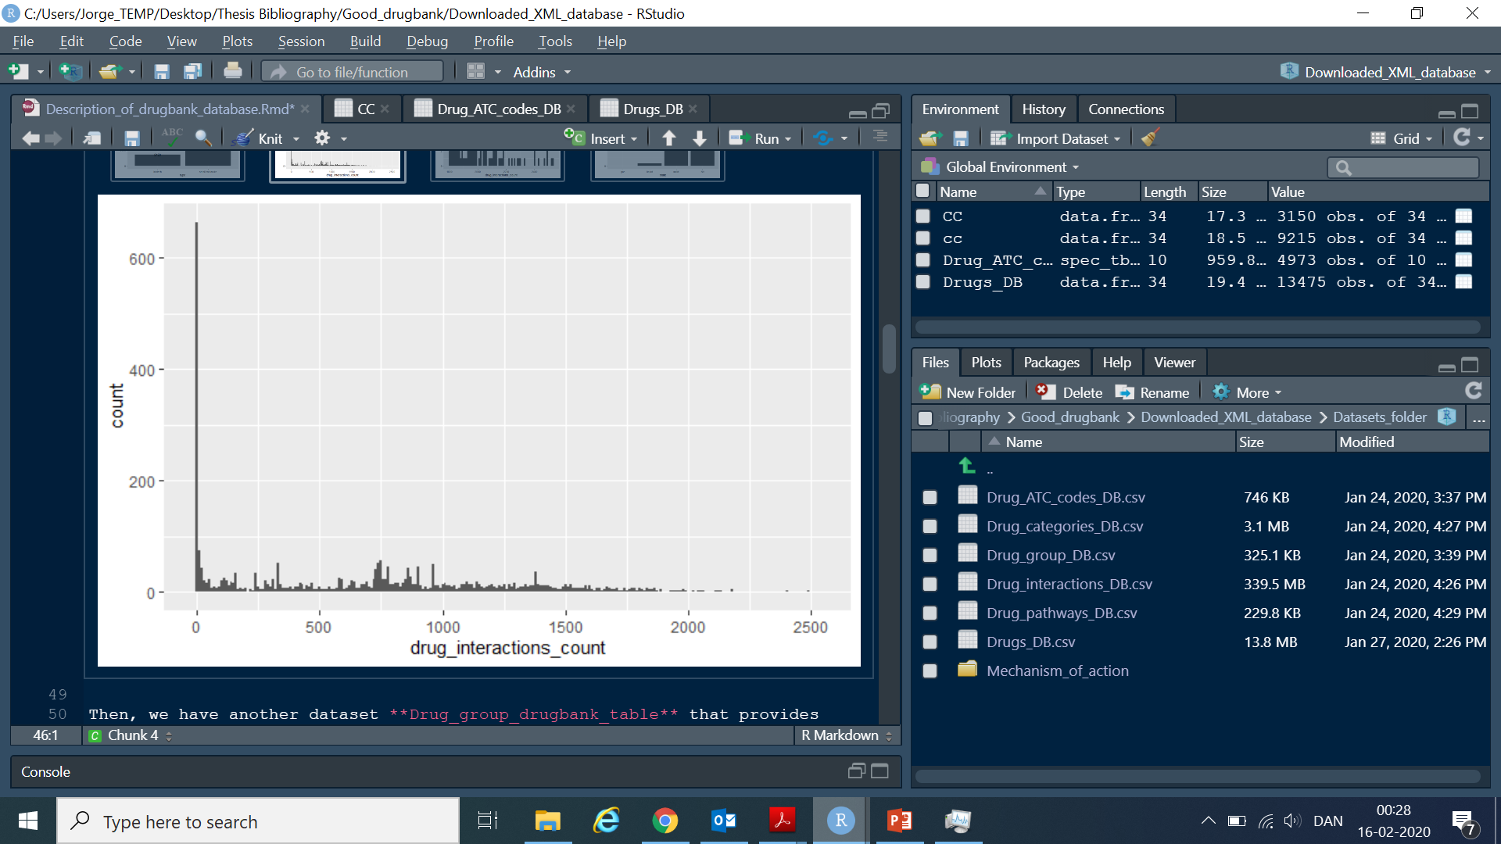
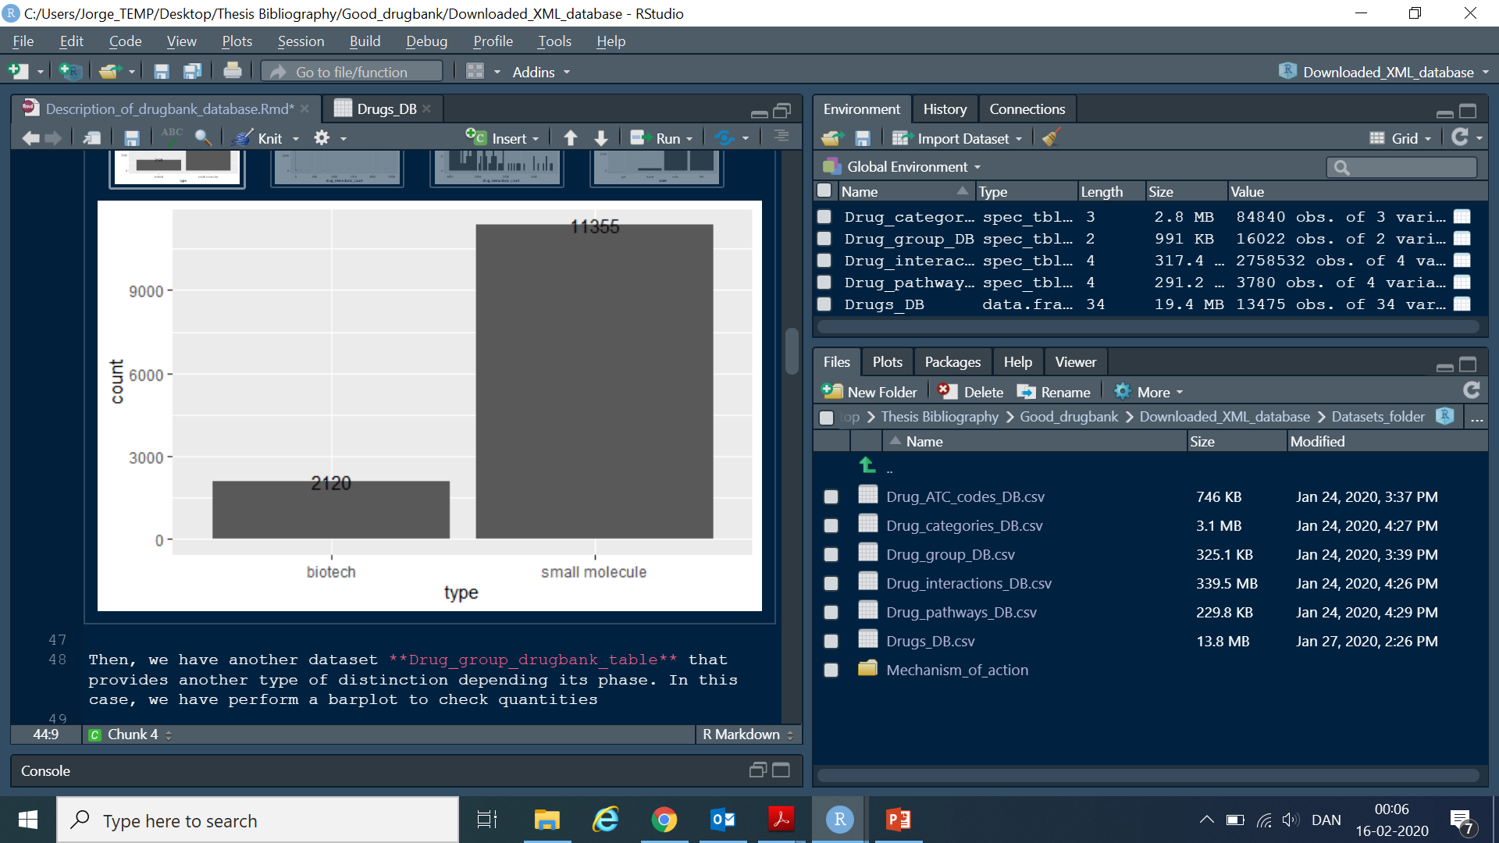
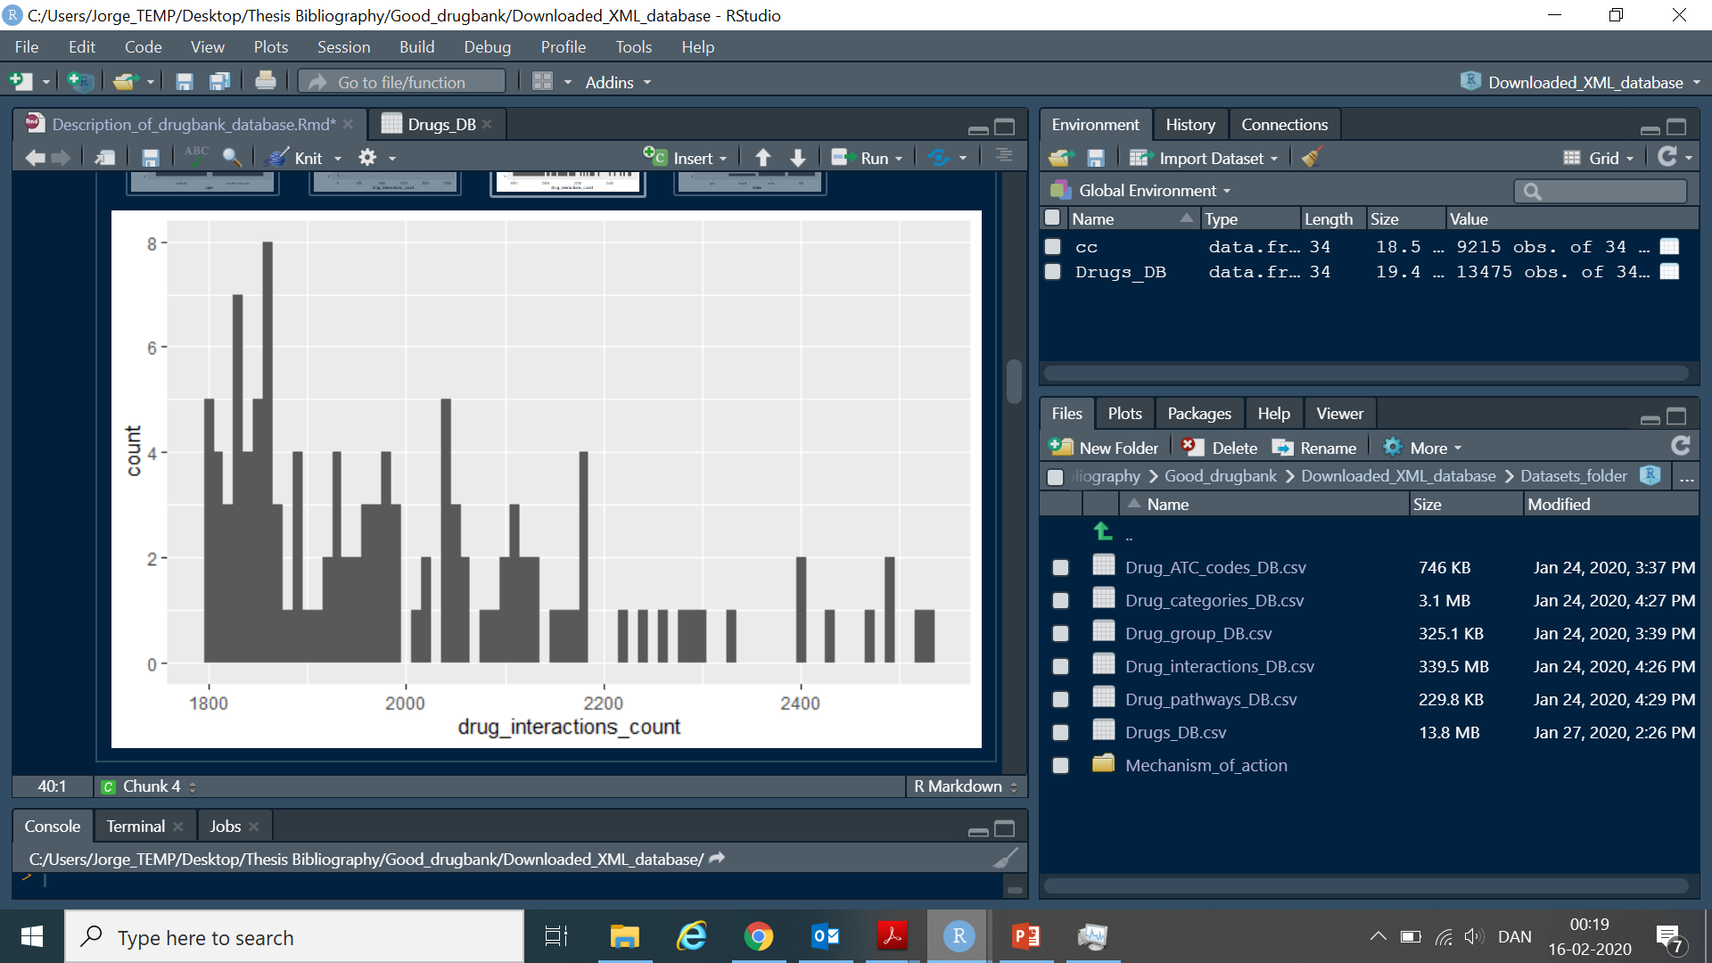
NUMBER OF INTERACTIONS
TYPE OF MOLECULE

Slide 7
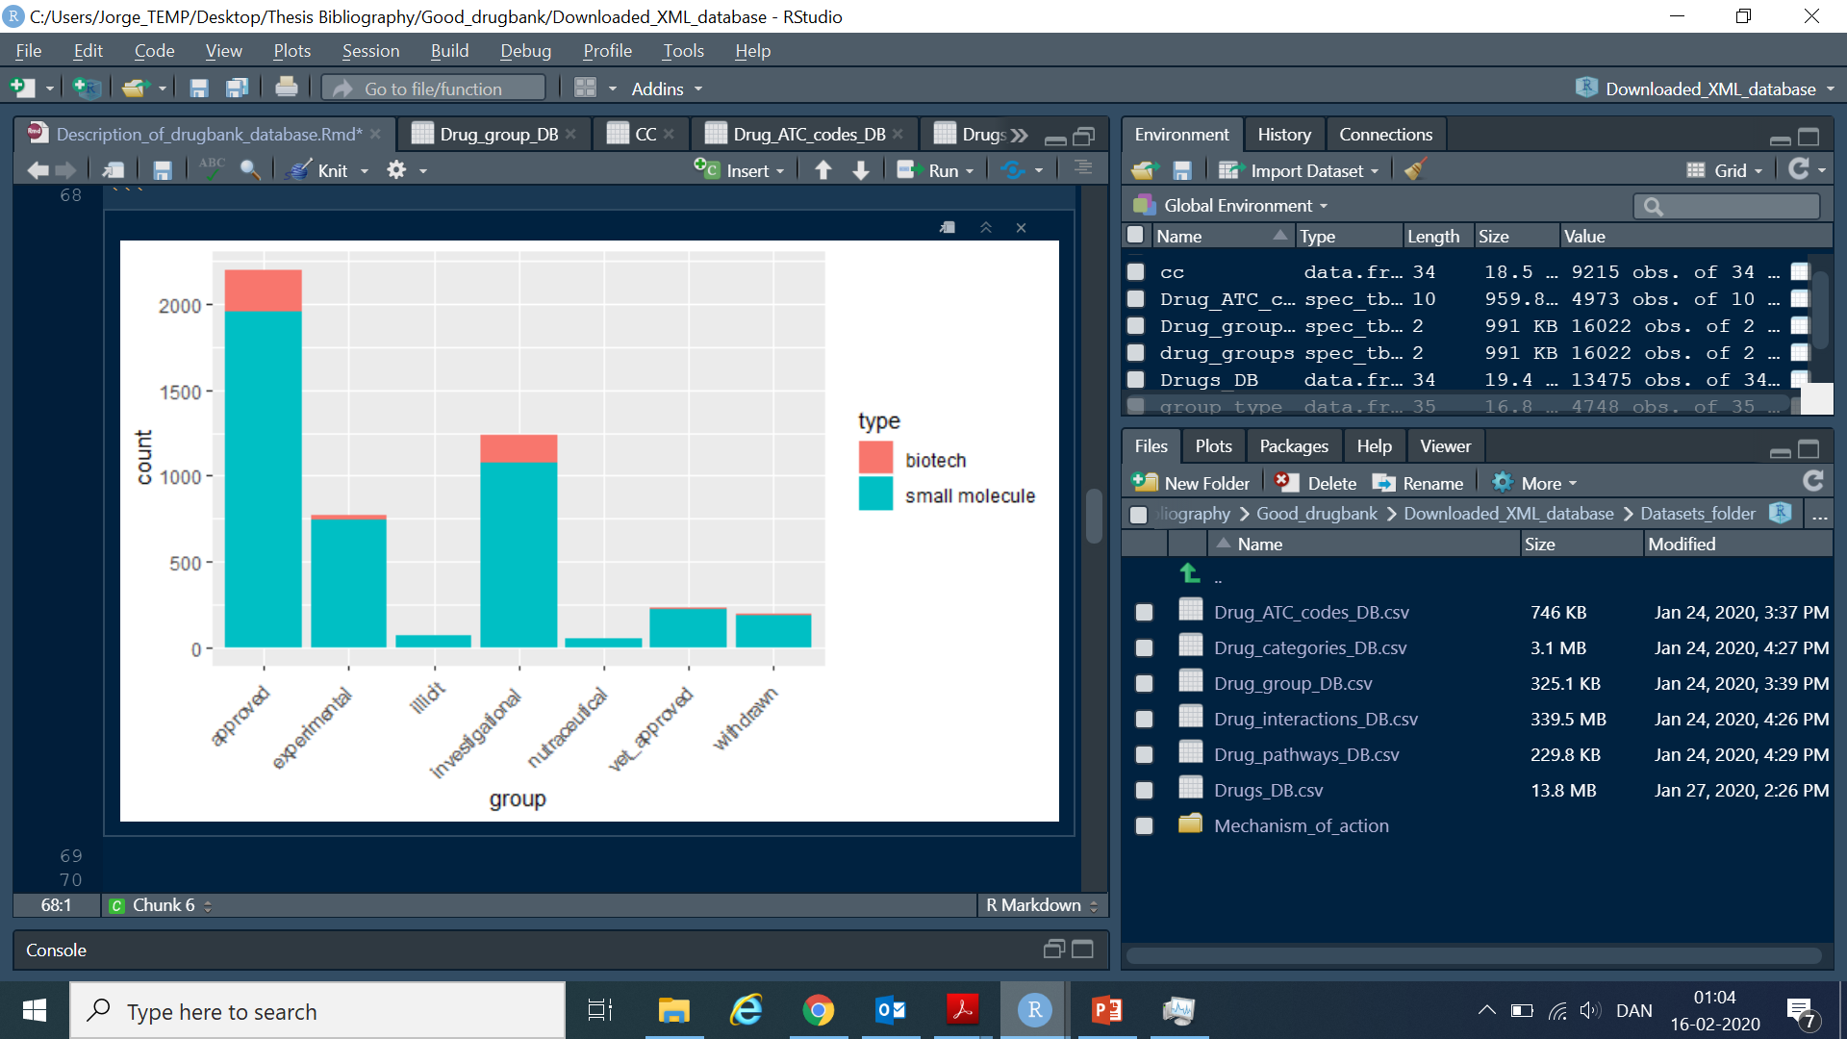
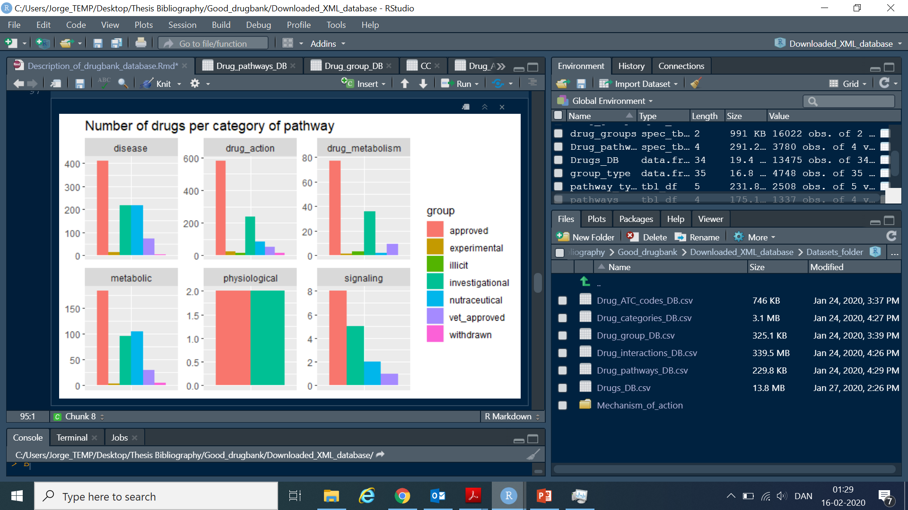
XML DATABASE; Groups and pathways

Slide 8
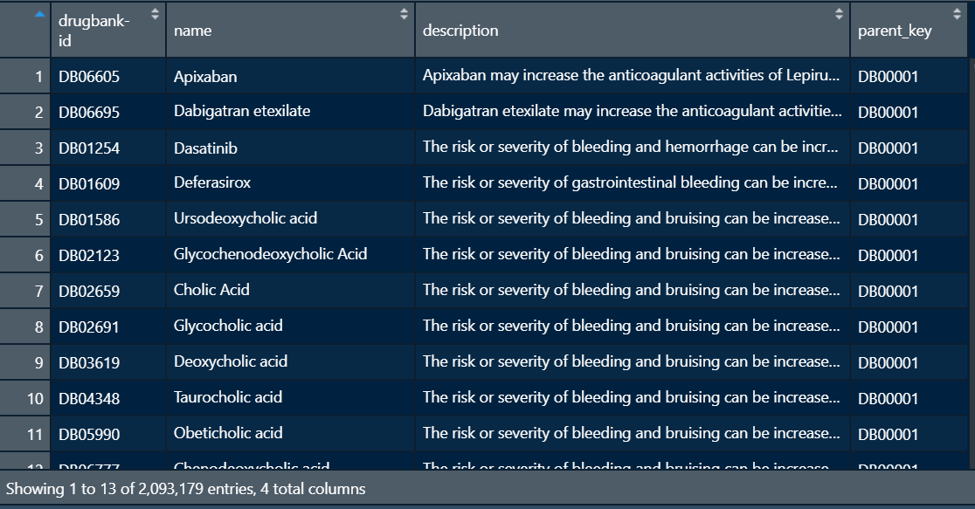
XML DATABASE; DDIs
Just a simple description.

Slide 9
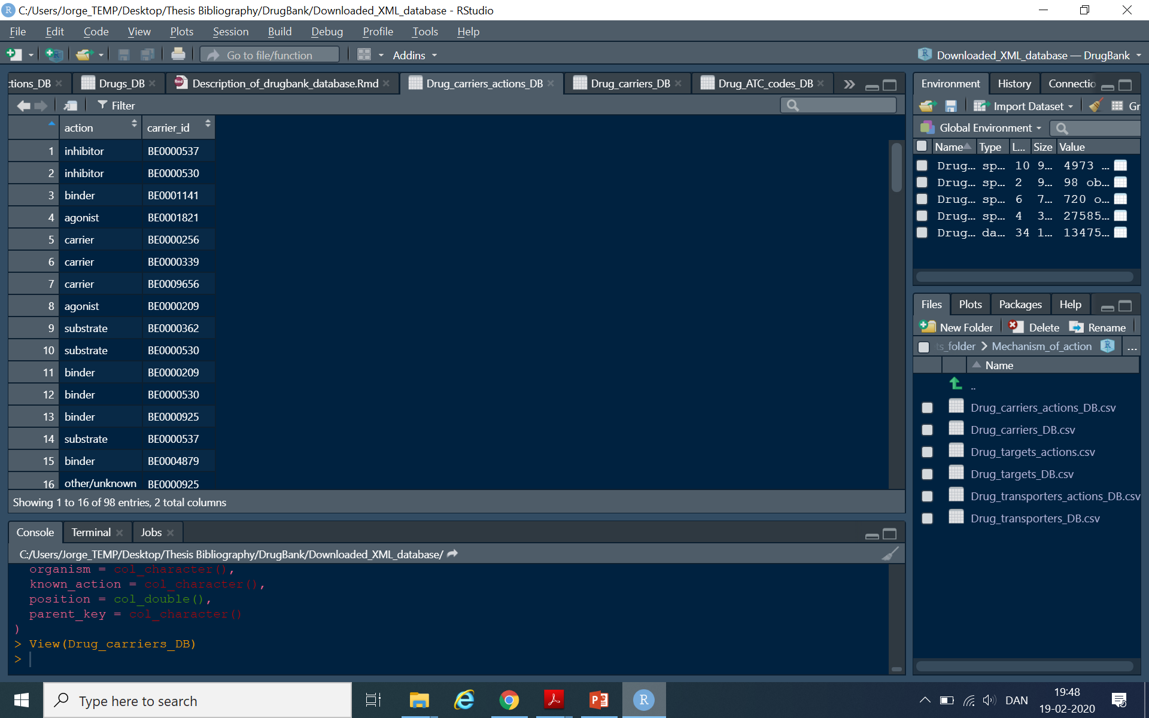
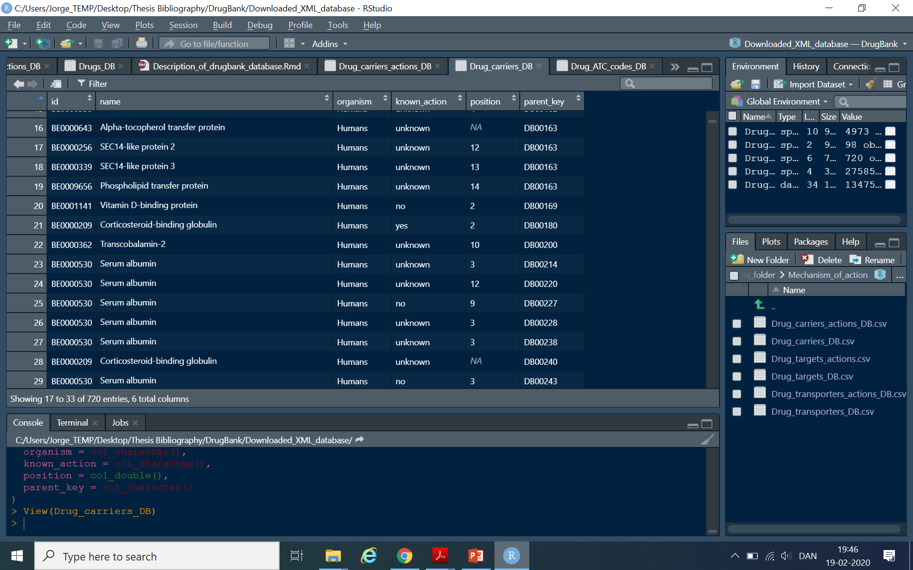
XML DATABASE; MECHANISM OF ACTION
Update
Each id may have several actions (Matrix?)

Slide 10
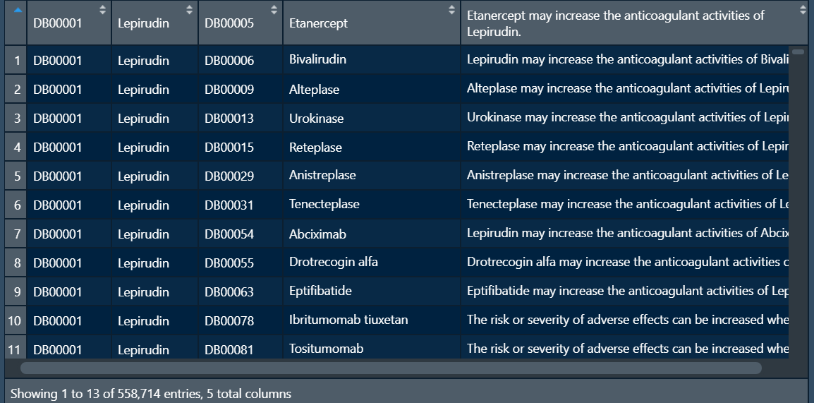
Dataset provided by github
201 db identifiers not recognized by primary key.
Adding new interactions?

Slide 11
SUMMARY
Datasets of interactions, categories, pathways.
Mapping codes such as ATC codes, Drugbank identiFIers, Rxnorm IDs…
Check if worthy other sources of ATC codes (UMLS from Cristina still incomplete).
Proceed with linkage with Rxnorm IDs. Drugs_DB dataset.
Explore if worthy mechanism of action of drugs. Refers to the targets, carriers and transporters that the drug is involved in.
Find a way to check the quantity of duplicates of PDDI5 from Github so as to see the new amount of interactions it apports.

Slide 12
KEGG
Information extracted from REST API of KEGG.
Just information about Drug interactions. Rest of it not publicly available.
PDDIs Github databases gave same information.
Update:
5411 drugs, 1243 mapped (Not sure with ATC code)
685565 interaction, 310897 mapped.
% of unknown maintained

Slide 13
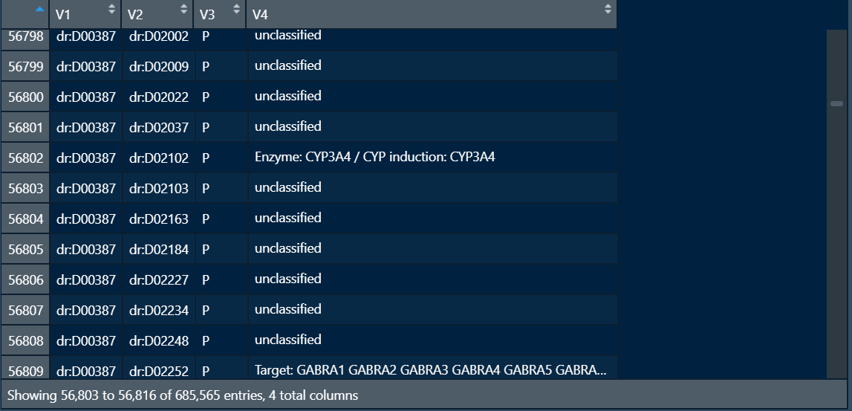
V3 refers to the designation of the interaction; if it is contraindication (CI) or precaution(P).
V4 refers to what interacts with or the action
85 % appear as having no target and are unclassified

Slide 14
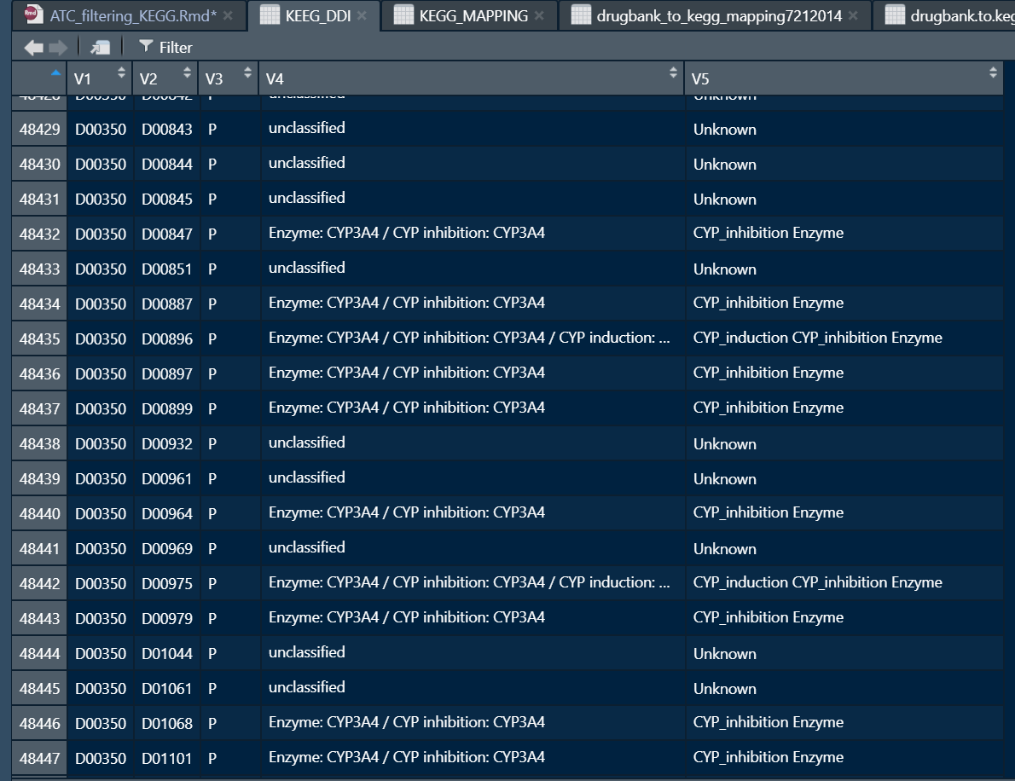
Matrix?
Updates
Target -> Genes
Enzymes
CYP inhibition
Transporter inhibition
CYP induction
Transporter induction
Same components (?)
Enzyme-target

Slide 15
SUMMARY
We have the targets and how it act on it; induction, inhibition…
As having Drugbank identifiers, we can check common DDIs. Depending the quantities linked, we can treat KEEG as a supplementary dataset of Drugbank.
Need to link with ATC codes so to subtract those not valid.
Still needed to look about all different outputs KEEG can give as outputs in the targets.

Slide 16
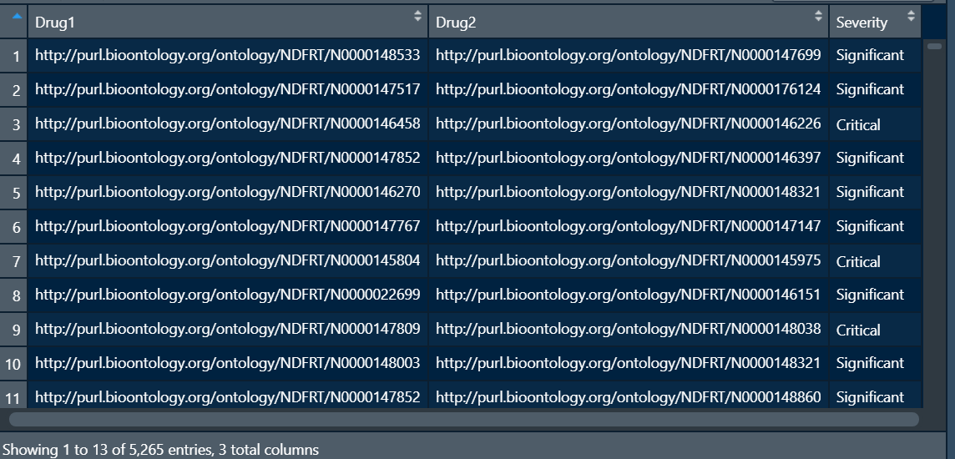
NDF-RT
Obtained from the PDDIs GitHub datasets.
Just gives the severity. No description.
32.6% are considered Critical.
67.4% are considered Significant.

Slide 17
SUMMARY
- There is available mapped dataset linking with Drugbank identifiers. Some of them are missing but can be done manually.
- As with KEGG, can be seen common DDIs and serve as a secondary dataset for the Drugbank one. Also should be mapped to Rxnorm_IDs.
- REST API not working anymore (Closed from January 2019), so I didn’t found any other source of information but the one of GitHub
Update:
2755 Identifiers, atc filtered minimizes down to 1206 (Although no missing id from mapping).
5265 interactions, 3708 filtered
Biased level -> Low

Slide 18
TWOSIDES
Obtained from the repository the Tattoneti lab has uploaded (http://tatonettilab.org/resources/nsides/).
Consists of
- Dataset of DDIs and its side effects
- Dataset of single drug side effects.
- A SQL table integrating mapping information.

Slide 19
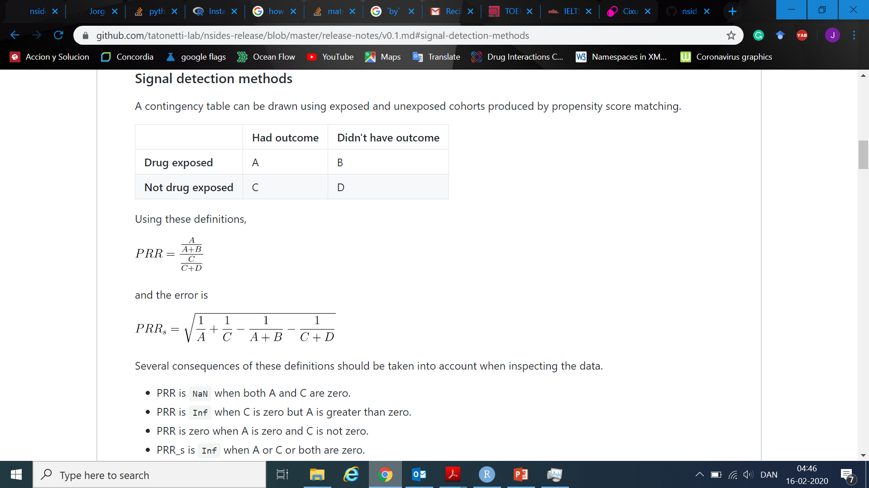
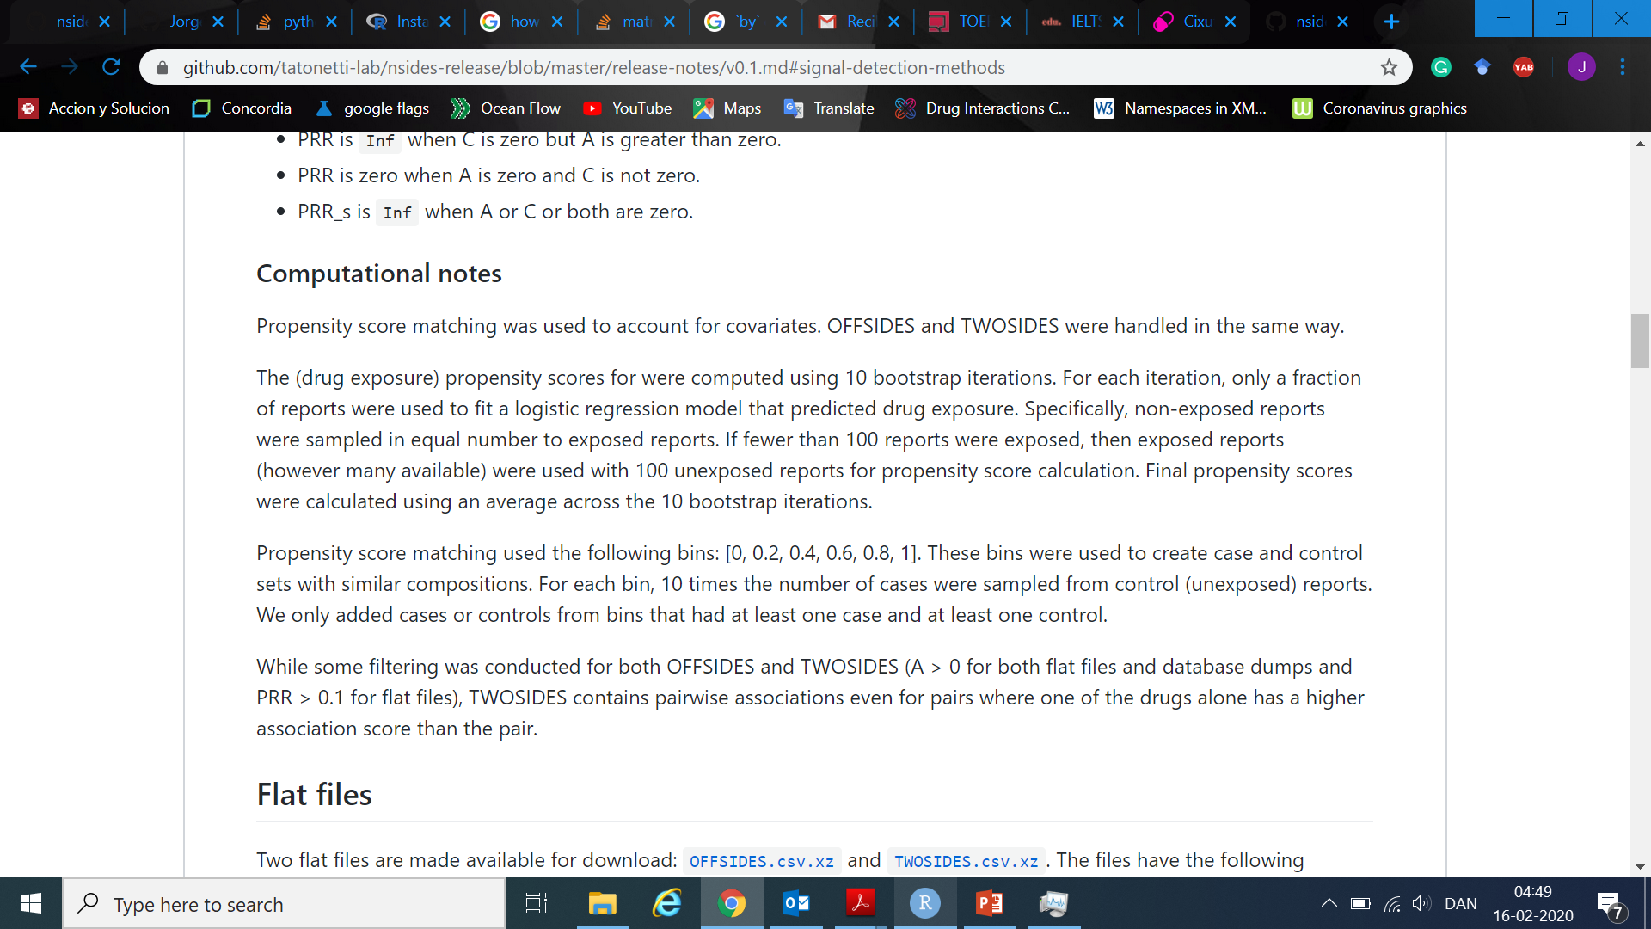
Information about the propensity scores used: https://github.com/tatonetti-lab/nsides-release/blob/master/release-notes/v0.1.md#signal-detection-methods

Slide 20
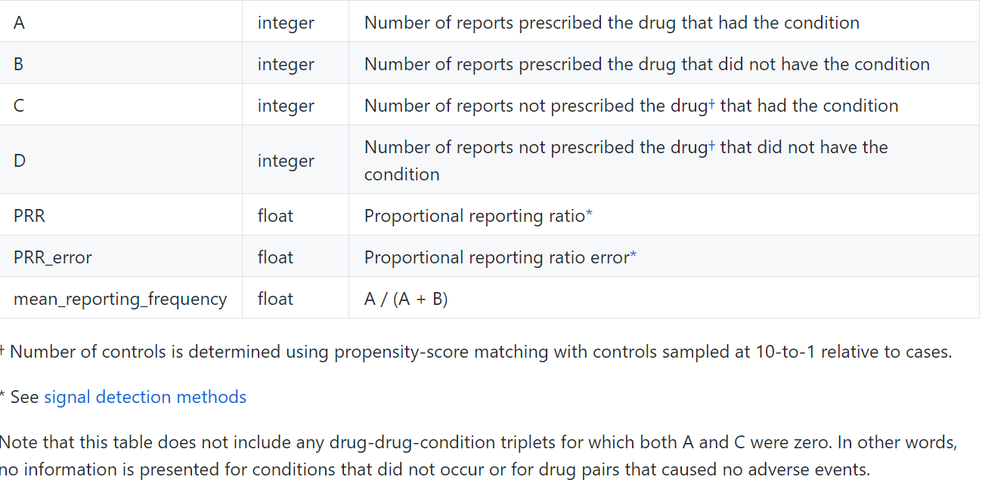
Not getting really well the idea of the propensity score.

Slide 21
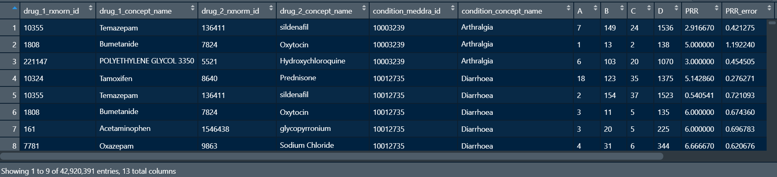
DDIs interaction.
Each row has a single condition_concept_name (Side effect), we see that many interactions are repeated as they have several side effects.
In total there are 1917 drugs and 12726 diseases/side effects for all the interactions.

Slide 22
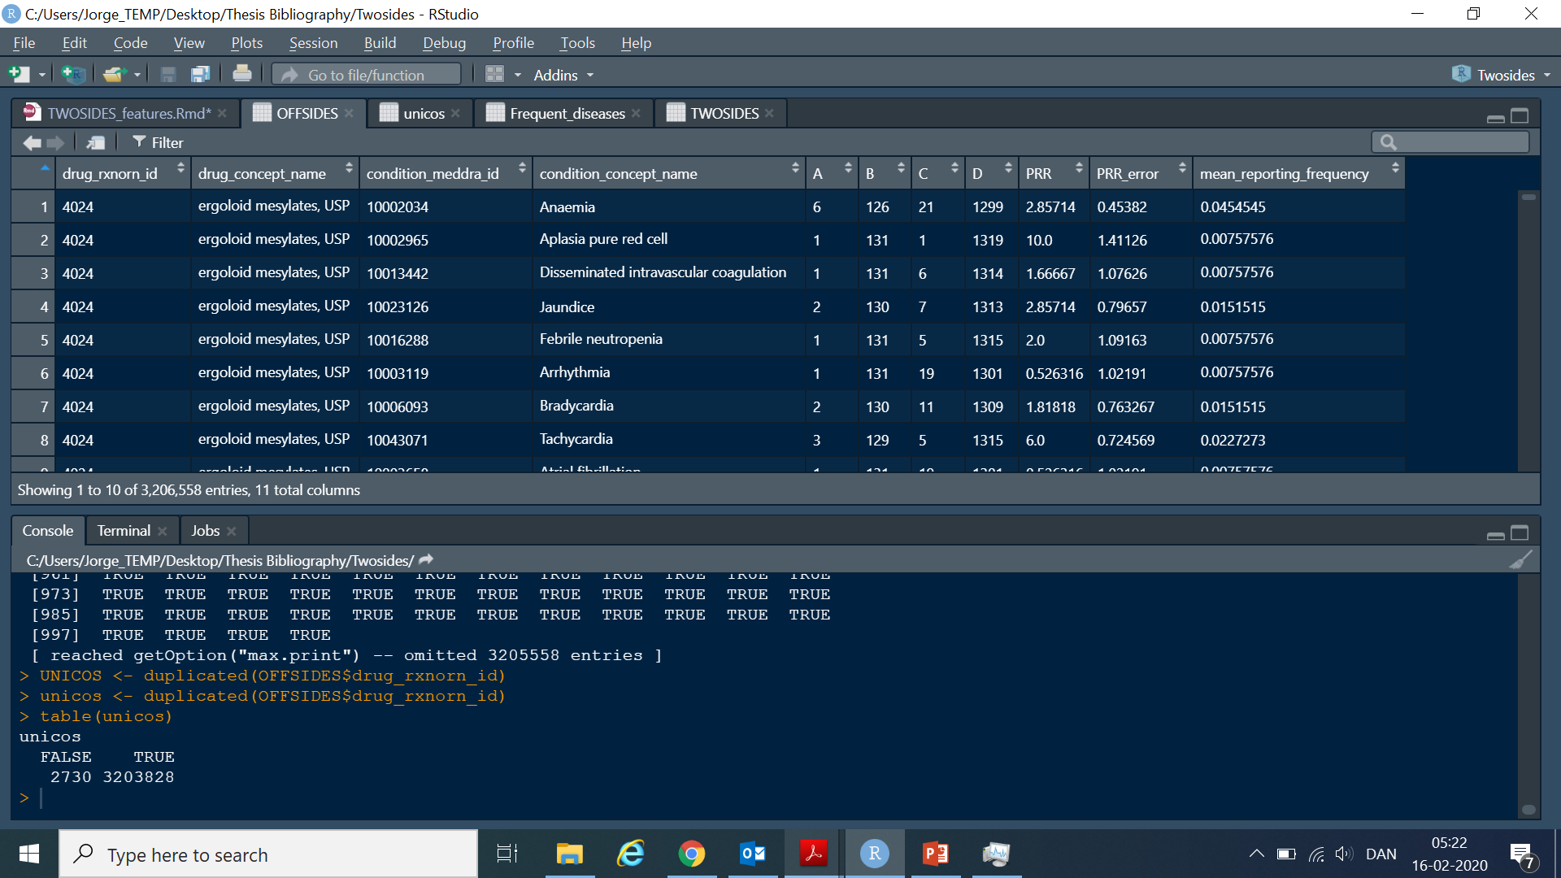
Single Drug side effect.
Same propensity scores applied than for the DDI dataset.
Check for both datasets
The most popular side effects.
There are recorded 2730 drugs and 14544 different side effects.

Slide 23
SUMMARY
Have to look into the SQL dataset to link identifiers. Moreover, there are Drugbank identifiers and Rxnorm_Identifiers so that can help with the problem of ATC_codes.
Need to understand correctly what is the outcome of the propensity scores and see how important can it be for our data.
It can be checked which are the drugs that do more interact. Not that easy!

Slide 24
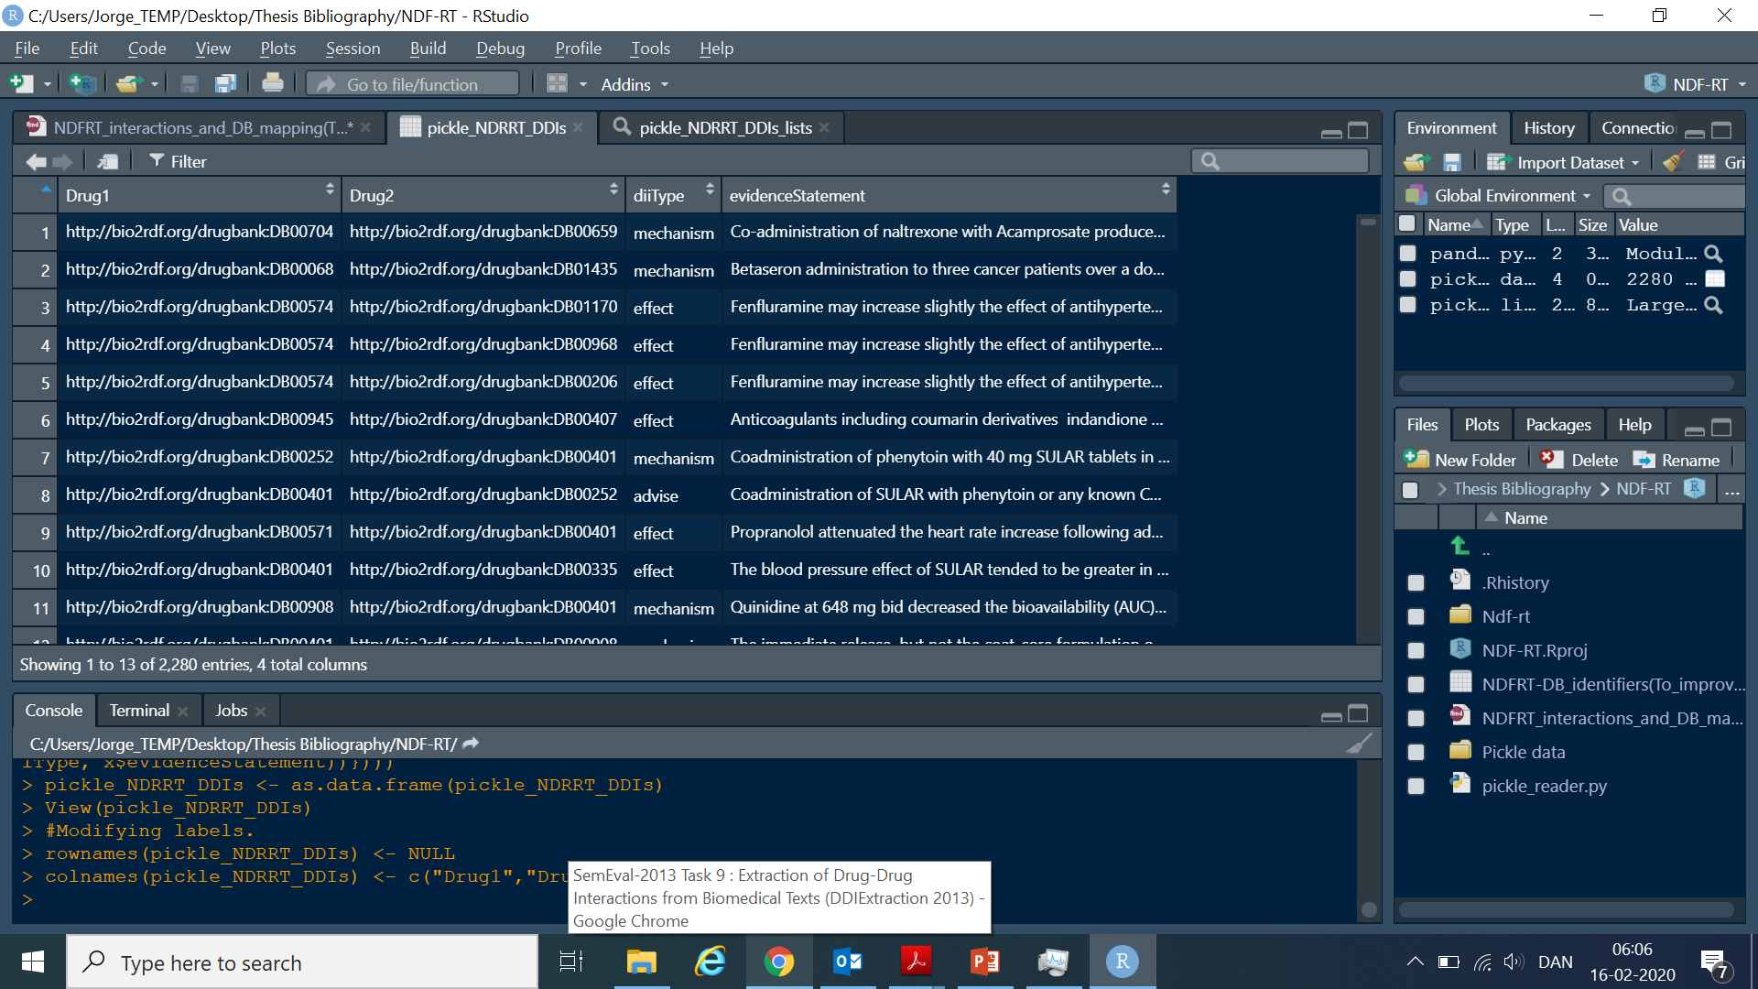
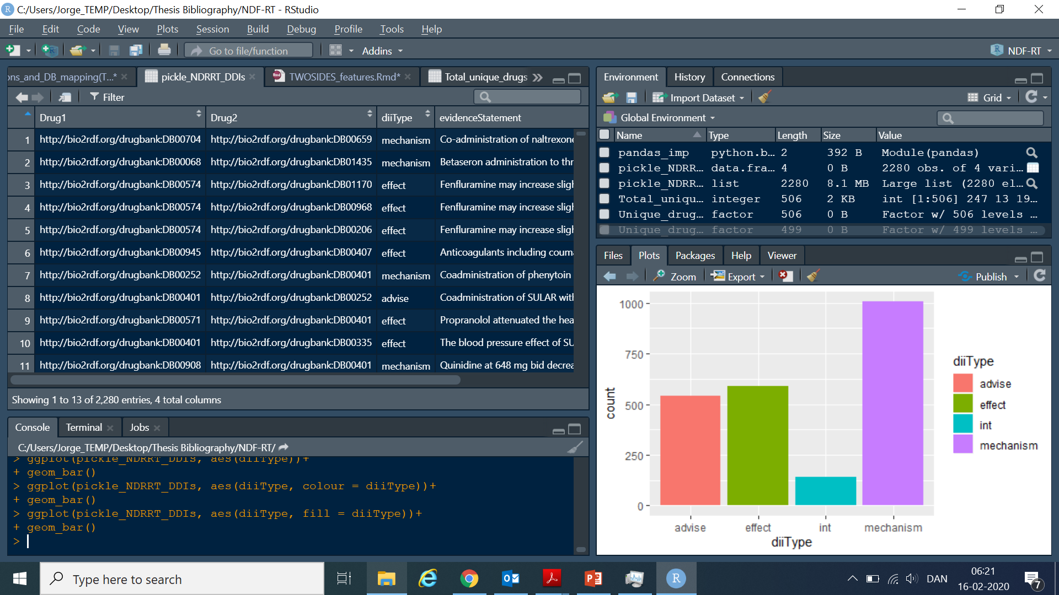
DDI CORPUS 2013
Extracted from datasets of the GitHub account, as NDF-RT.
Gives description of the
outcome of the interaction
There are 506 distinct
drugs

Slide 25
SUMMARIZE
Search/ask for this sort of identification of DDIs.
Already have Drugbank identifiers, need to be mapped to Rxnorm_IDs. Again, we can check if there are common interactions between them.
They still need to be applied the ATC_code filtering.s
UPDATES:
678 Drugs, 649 mapped to Drugbank
2280 DDI, 2160 mapped to Drugbank
Biased level, very low.

